Slide 1
On the reliably small effect size in microbiome association
studies in humans
Anthony Fodor
Department of Bioinformatics and Genomics
UNC Charlotte

Slide 2
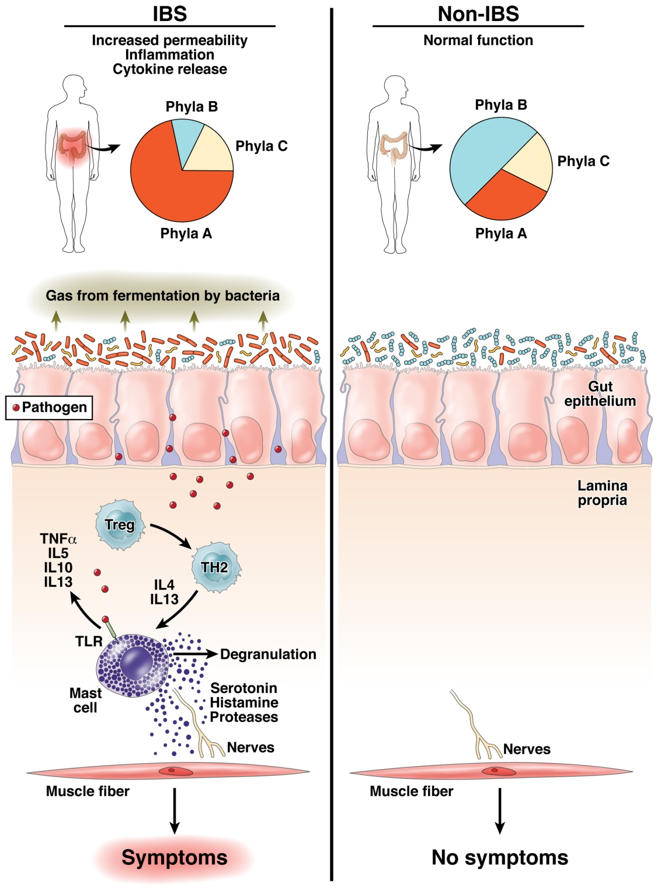

Does human variability in the microbiome impact health and disease?
Fodor & Talley. Gastroenterology. 2011

Slide 3
Reproducibility is enabled when there is a consistent signal
that is larger than measurement error and biological variability

Slide 4
Reproducibility is enabled when there is a consistent signal
that is larger than measurement error and biological variability
Across studies, effect sizes of associations with human phenotypes are reliably very small

Slide 5
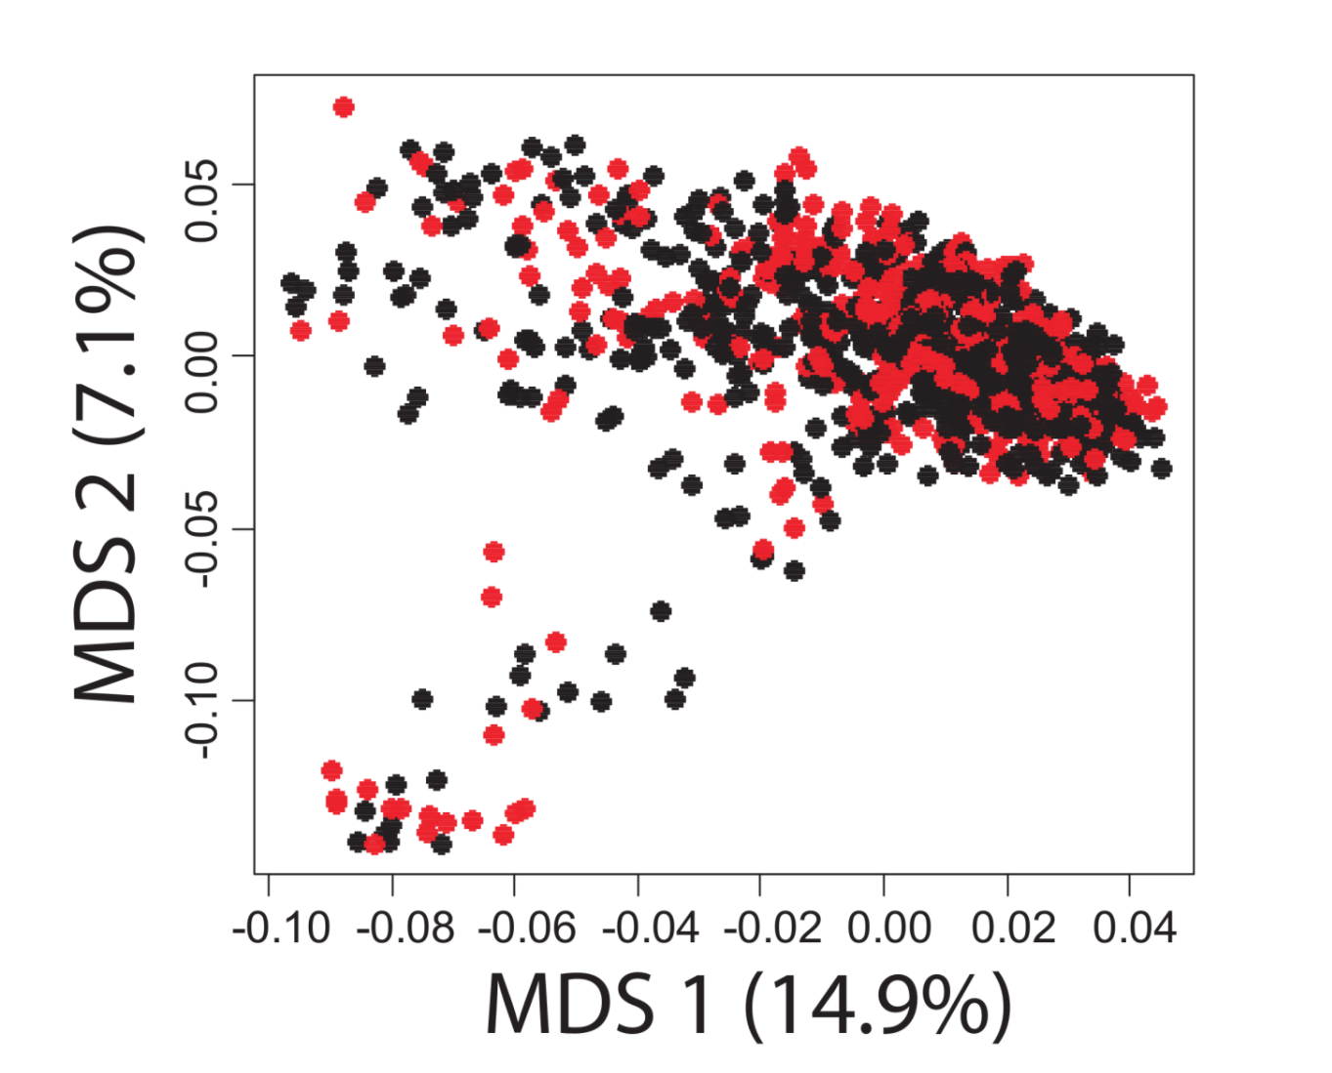
A case-control study in Colonic Diverticulosis
An Aberrant Microbiota is not Strongly Associated with Incidental Colonic Diverticulosis Roshonda B. Jones, Anthony A. Fodor, Anne F. Peery, Matthew C. B. Tsilimigras, Kathryn Winglee, Amber McCoy,Michael Sioda ,Robert S. Sandler, Temitope O. Keku2. In revision.

Slide 6
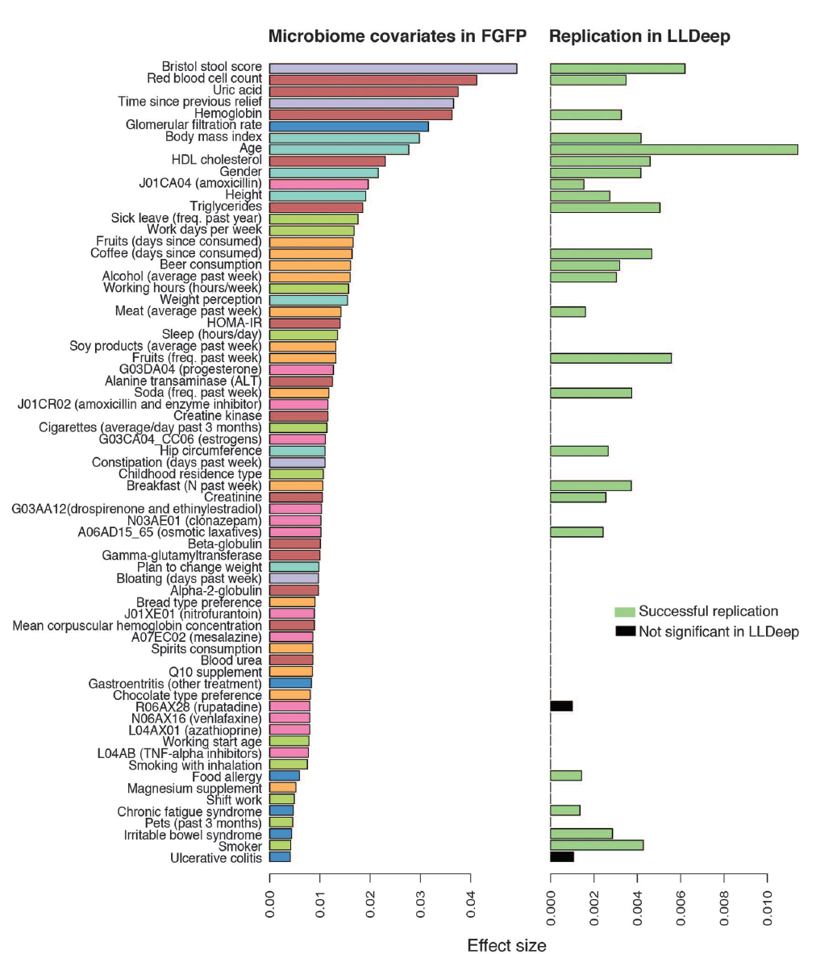
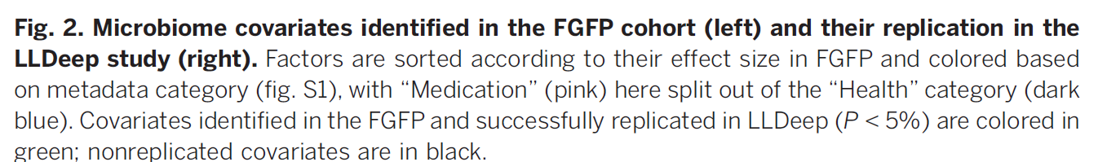
Microbial community composition and gene content is poorly associated with healthy variation
Initial analysis: 503 metadata variables
69 significant at 10% FDR
26 have analog in replication cohort
24 of these are significant
(but effect sizes in replicate cohort drop to << .01)
Power estimates suggests > 1600 subjects
needed to power BMI study…
Gwen Falony et al. Population-level analysis of gut microbiome variation -Science 29 Apr 2016

Slide 7
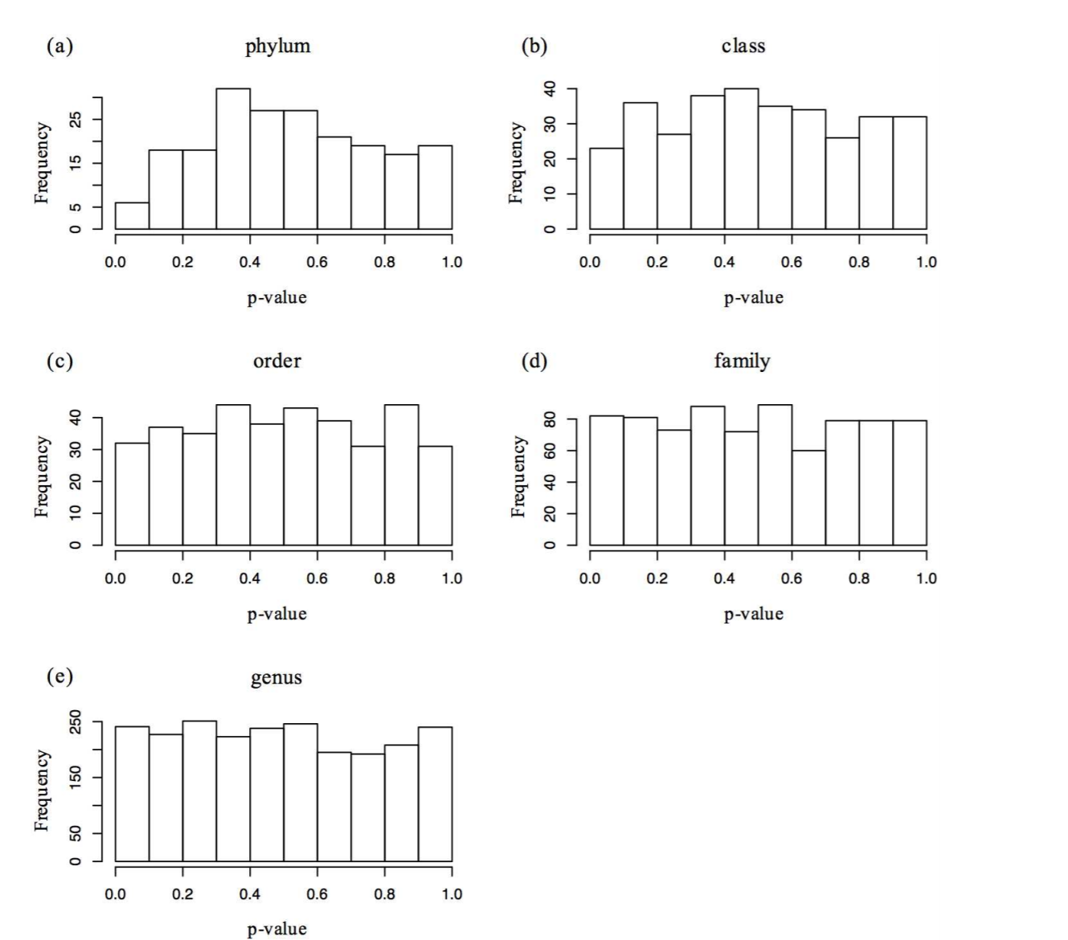

Small effect sizes are hard to tell from negative results at reasonable sample sizes…

Slide 8
Why are effect sizes so small?
Hypothesis: Within a pipeline, measurements are not accurate

Slide 9
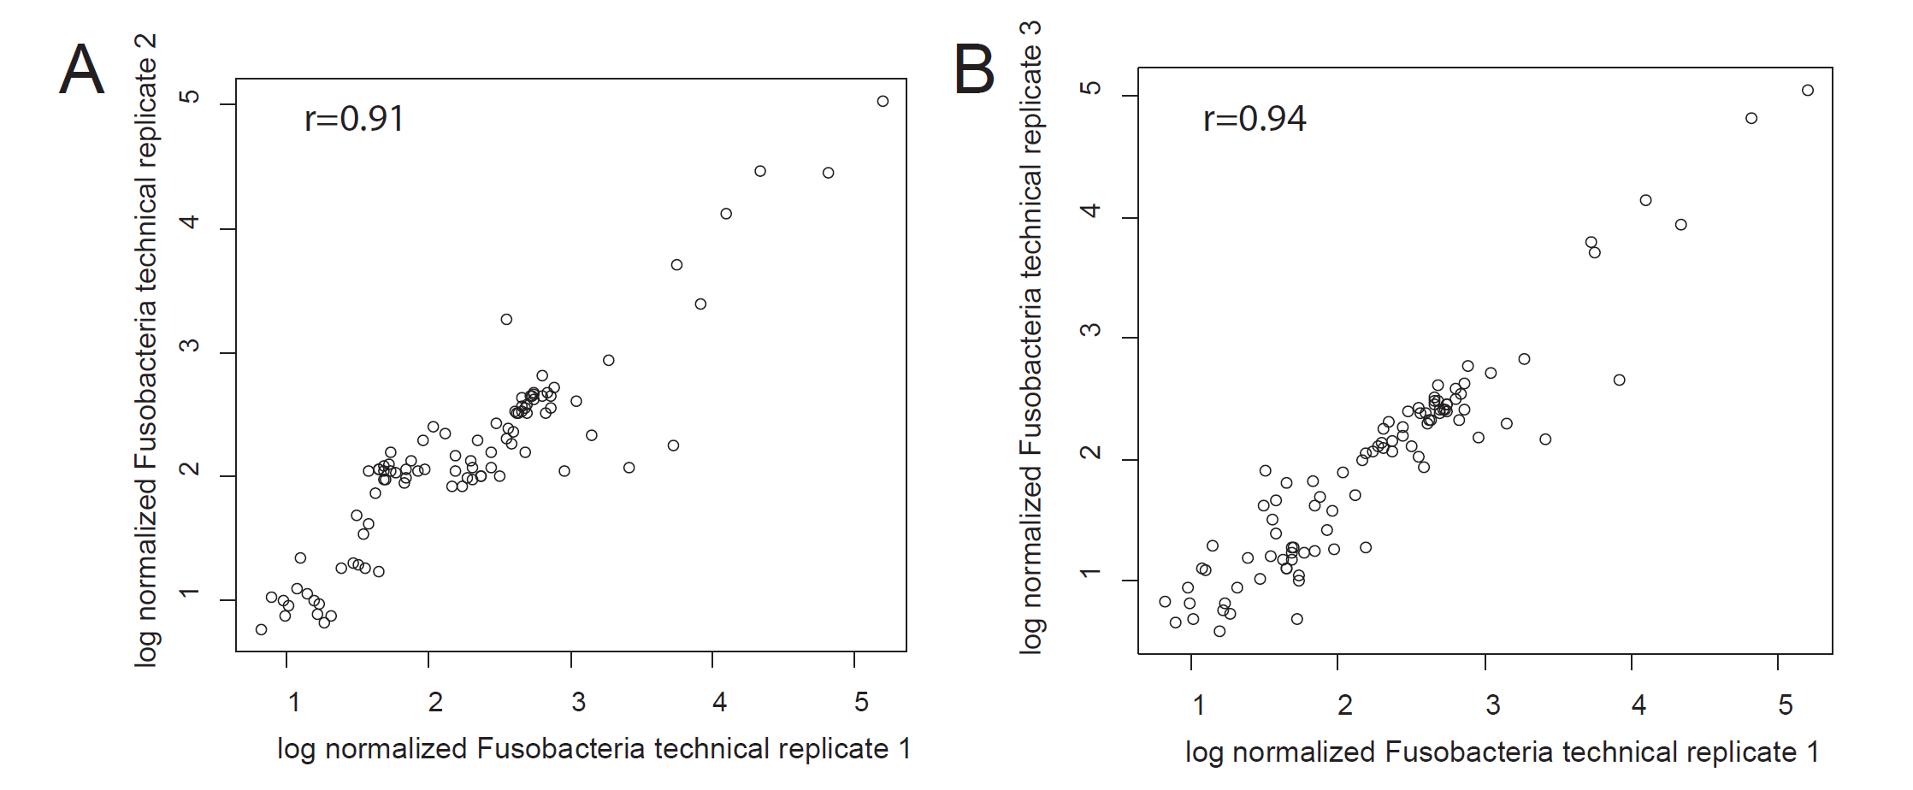
Within a pipeline, PCR and extraction steps can be highly replicable
Rifaximin Treatment is Associated With Small, Transient Decreases in Multiple Taxa in the Human Gut Microbial Community. Fodor et al. In revision, Gut Microbes

Slide 10
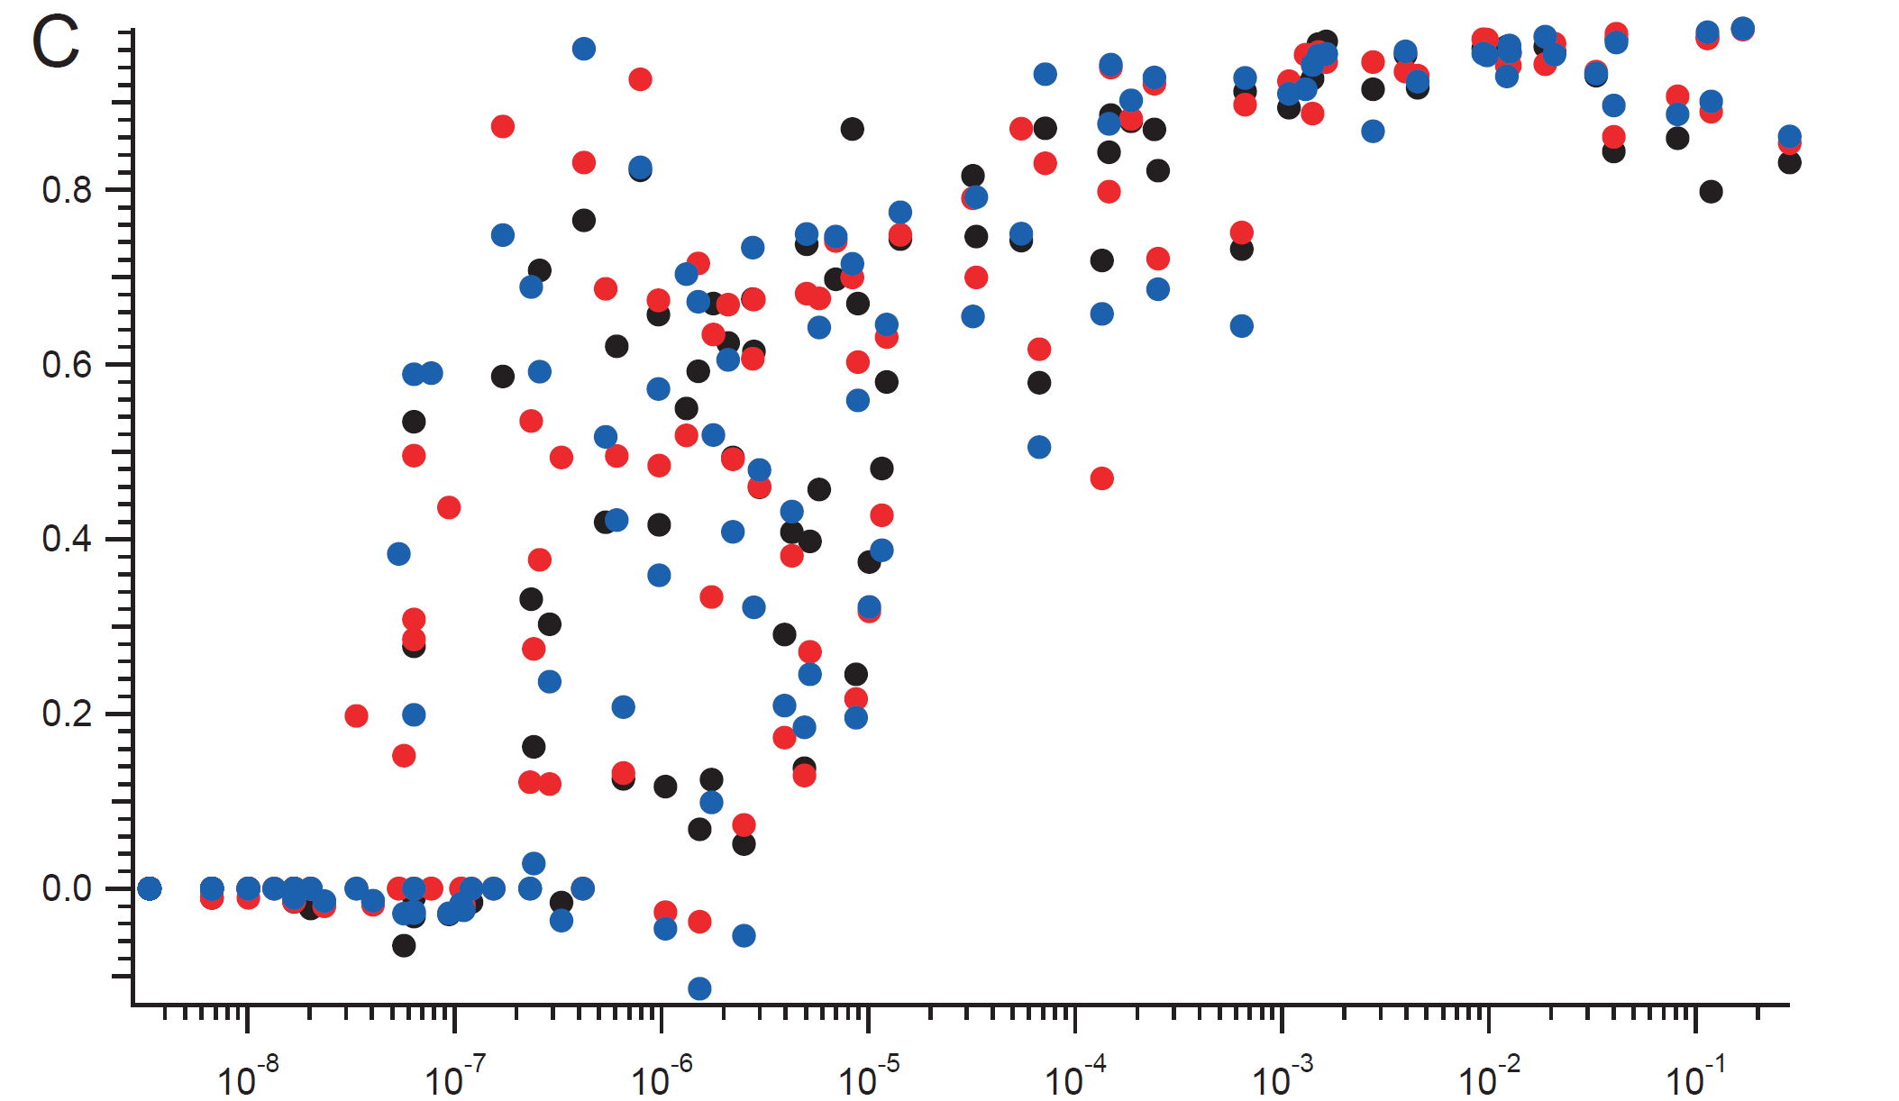
Within a batch, reproducibility can be very high for non-rare taxa
.8
Correlation Coefficient
.6
.4
.2
.0
10⁻⁸
10⁻⁷
10⁻⁶
10⁻⁵
10⁻⁴
10⁻³
10⁻²
10⁻¹
Relative Abundance

Slide 11
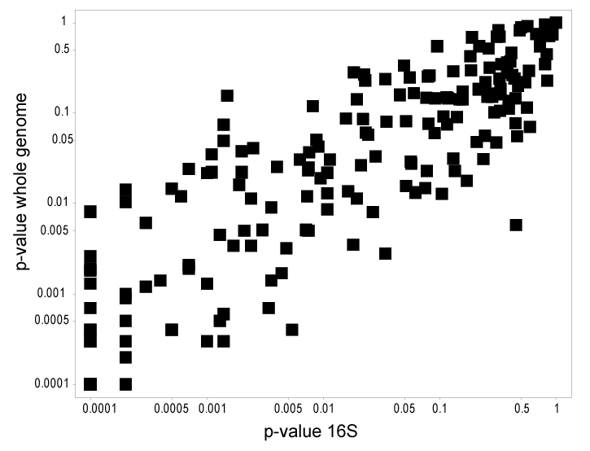
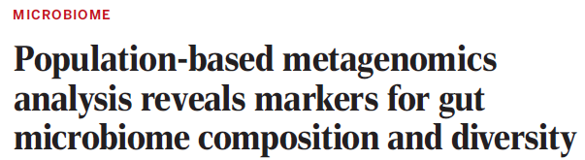
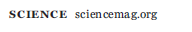
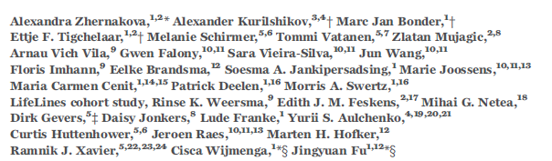
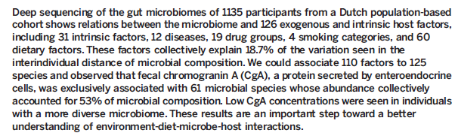
Within a pipeline, inference performed on WGS and 16S can produce very similar results
Supplementary table 7

Slide 12
Why are effect sizes so small?
Hypothesis: Within a pipeline, measurements are not accurate

Slide 13
Why are effect sizes so small?
Hypothesis: Within a pipeline, measurements are not accurate

Slide 14
Microbial community composition and gene content is poorly associated with healthy variation
Initial analysis: 503 metadata variables
69 significant at 10% FDR
26 have analog in replication cohort
24 of these are significant
(but effect sizes in replicate cohort drop to << .01)
Power estimates suggests > 1600 subjects
needed to power BMI study…
Falony et al. Population-level analysis of gut microbiome variation -Science 29 Apr 2016

Slide 15
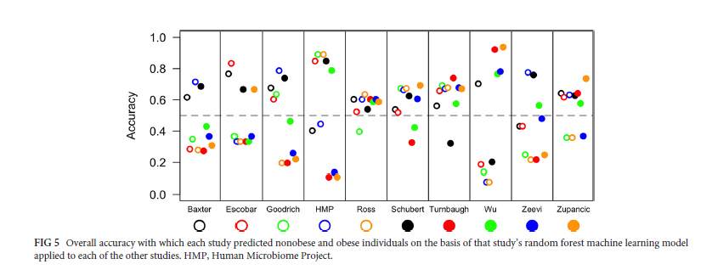
Replicability across studies appears especially poor
Sze and Schloss - Looking for a Signal in the Noise: Revisiting Obesity and the Microbiome– mbio, 2016

Slide 16
Why are effect sizes so small?
Hypothesis: Within a pipeline, measurements are not accurate

Slide 17
Why are effect sizes so small?
Hypothesis: Within a pipeline, measurements are not accurate
Hypothesis: Even with correction for multiple hypothesis testing, there is a tendency for our models to overfit

Slide 18

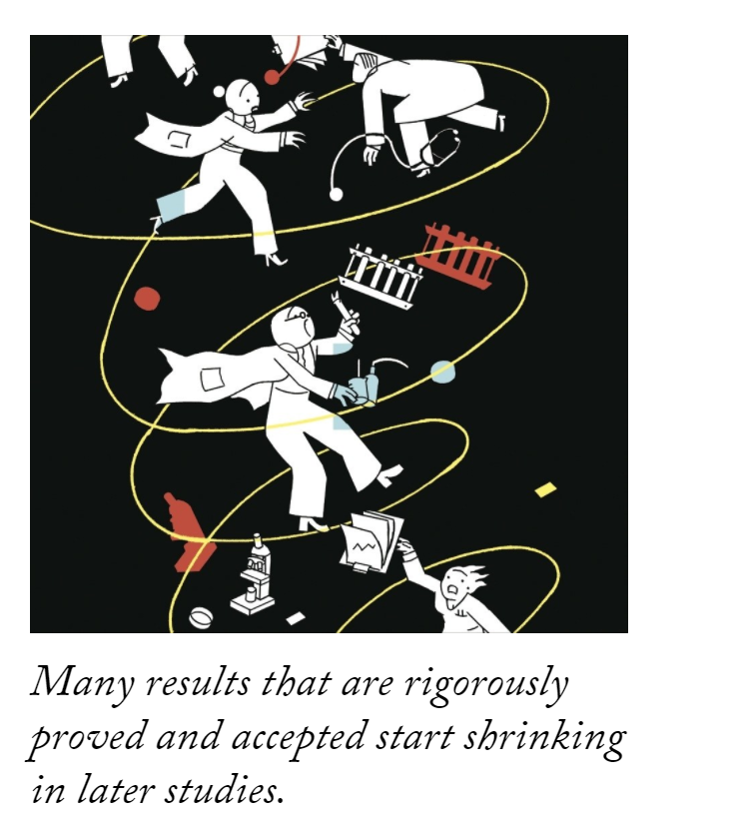

Slide 19
Why are effect sizes so small?
Hypothesis: Within a pipeline, measurements are not accurate
Hypothesis: Even with correction for multiple hypothesis testing, there is a tendency for our models to overfit

Slide 20
Why are effect sizes so small?
Hypothesis: Within a pipeline, measurements are not accurate
Hypothesis: Even with correction for multiple hypothesis testing, there is a tendency for our models to overfit
✓

Slide 21
Why are effect sizes so small?
Hypothesis: Within a pipeline, measurements are not accurate
Hypothesis: Even with correction for multiple hypothesis testing, there is a tendency for our models to overfit
Hypothesis: Across pipelines, batch effects can induce substantial variation
✓

Slide 22
Within a pipeline, PCR and extraction steps can be highly replicable
Rifaximin Treatment is Associated With Small, Transient Decreases in Multiple Taxa in the Human Gut Microbial Community. Fodor et al. In revision, Gut Microbes

Slide 23
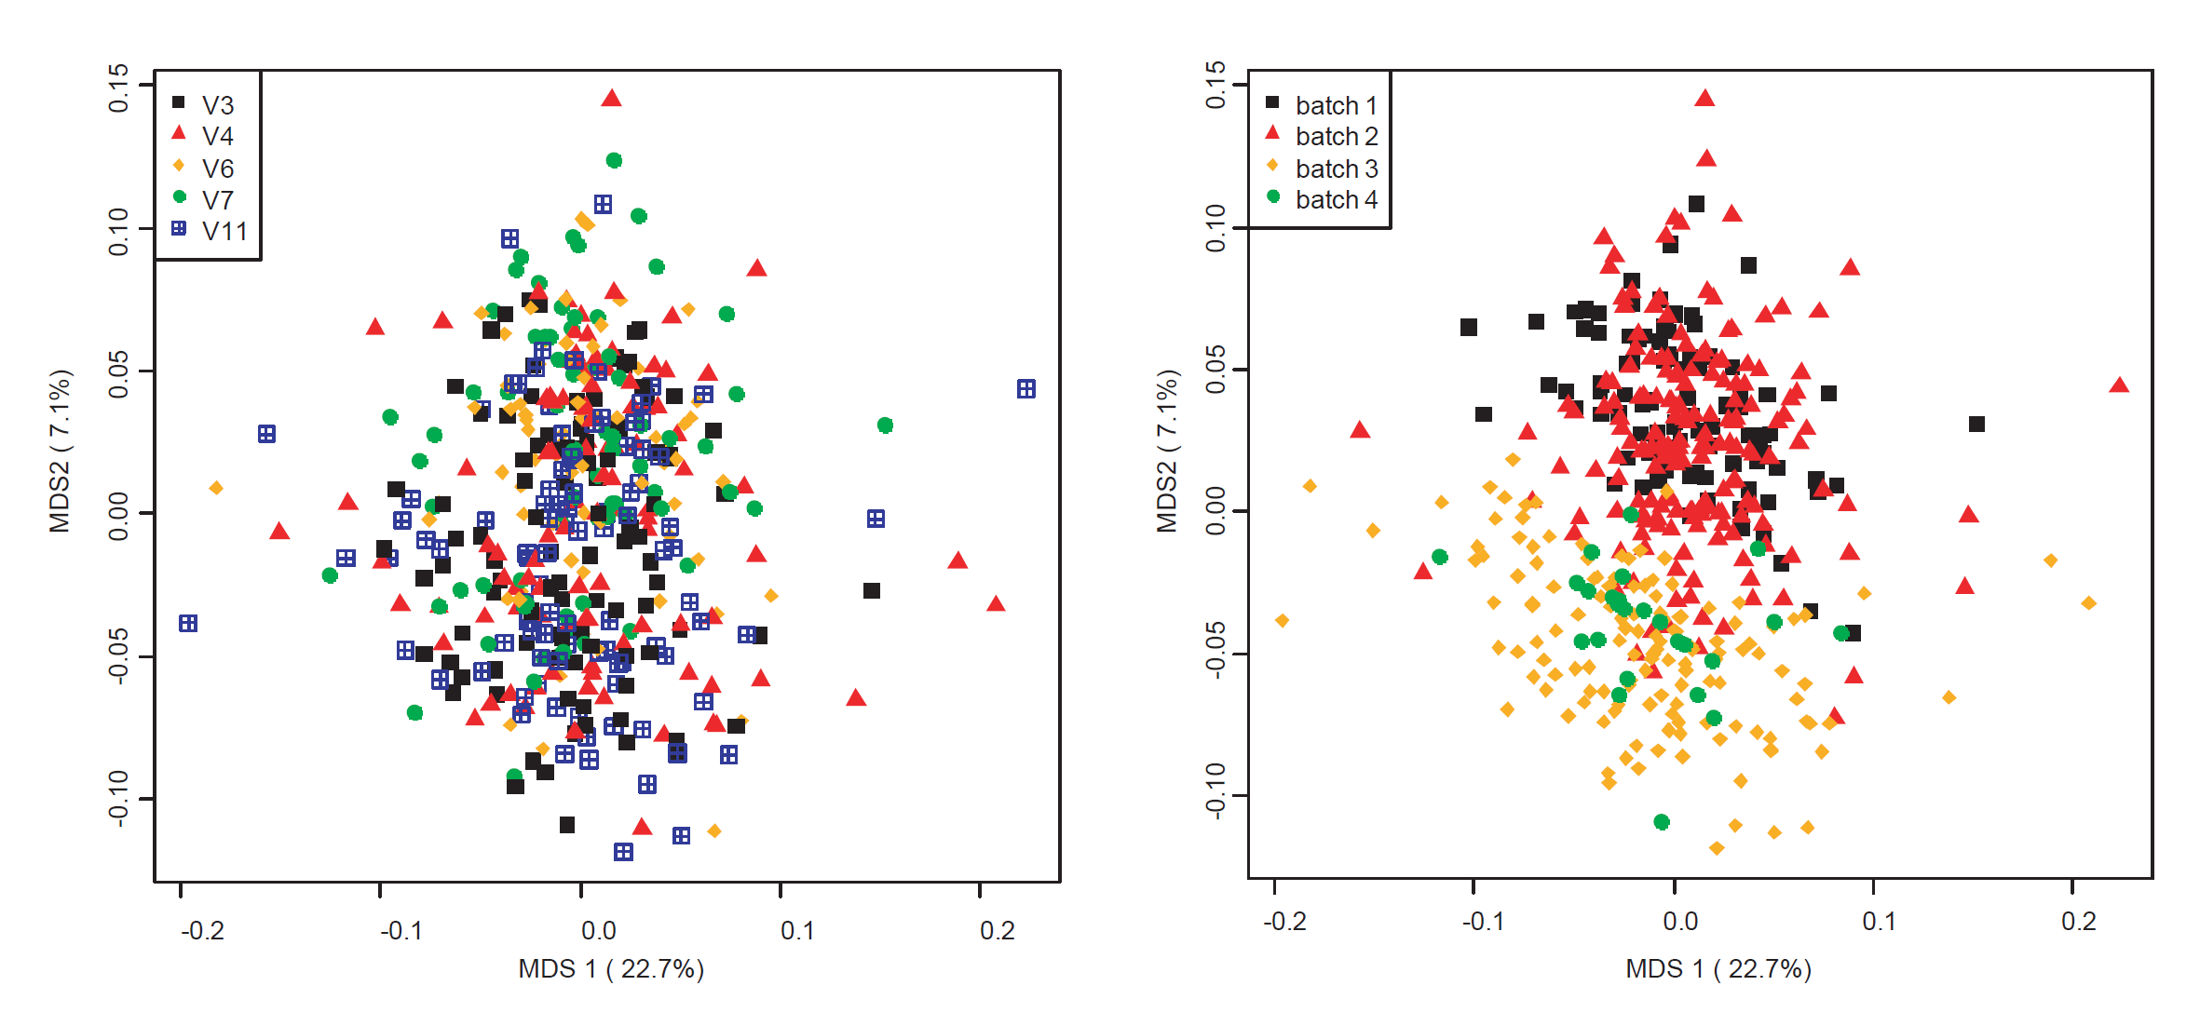
Batches are “islands”
Rifaximin Treatment is Associated With Small, Transient Decreases in Multiple Taxa in the Human Gut Microbial Community. Fodor et al. In revision, Gut Microbes

Slide 24
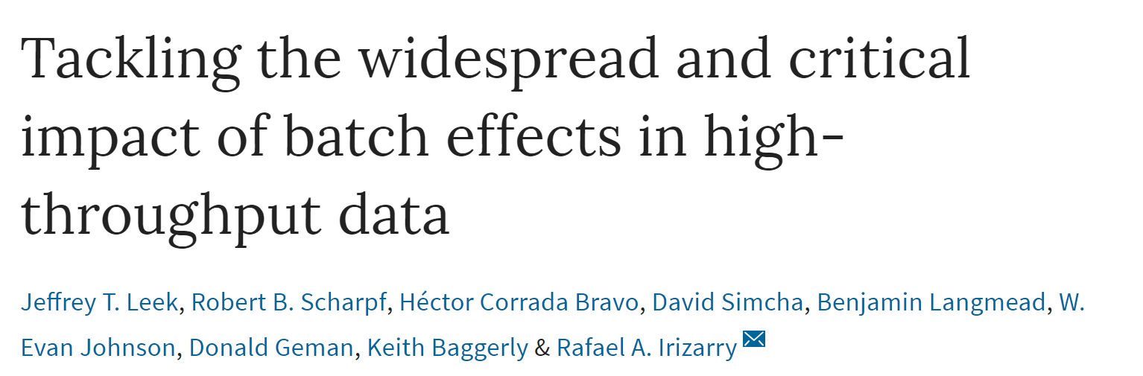
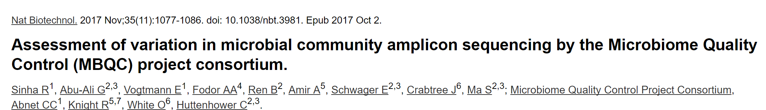

Slide 25
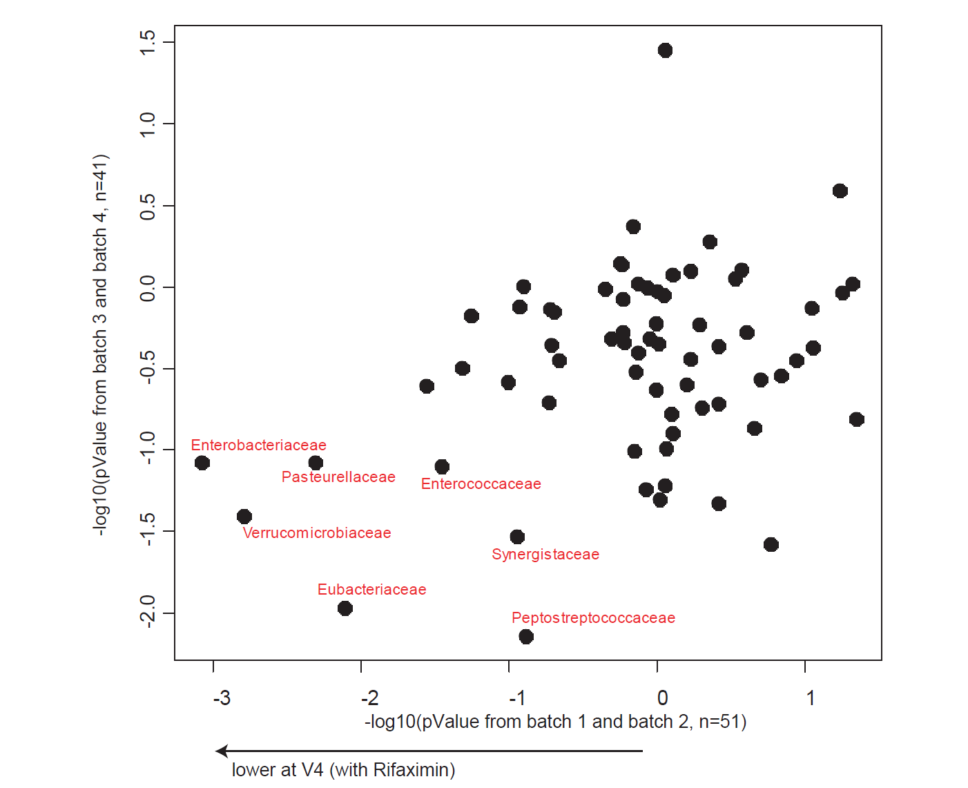
Inference can (hopefully) survive across batch effects

Slide 26
Why are effect sizes so small?
Hypothesis: Within a pipeline, measurements are not accurate
Hypothesis: Even with correction for multiple hypothesis testing, there is a tendency for our models to overfit
Hypothesis: Across pipelines, batch effects can induce substantial variation
✓

Slide 27
Why are effect sizes so small?
Hypothesis: Within a pipeline, measurements are not accurate
Hypothesis: Even with correction for multiple hypothesis testing, there is a tendency for our models to overfit
Hypothesis: Across pipelines, batch effects can induce substantial variation
✓
✓

Slide 28
Why are effect sizes so small?
Hypothesis: Within a pipeline, measurements are not accurate
Hypothesis: Even with correction for multiple hypothesis testing, there is a tendency for our models to overfit
Hypothesis: Across pipelines, batch effects can induce substantial variation
✓
✓
Hypothesis: Biological “island” effects across space and time impact cross-sectional measures

Slide 29
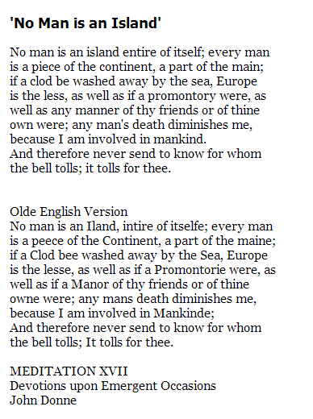

http://web.cs.dal.ca/~johnston/poetry/island.html
http://upload.wikimedia.org/wikipedia/commons/8/8f/JohnDonne.jpg

Slide 30
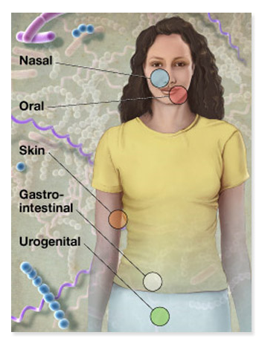

For microbes, everyone (and everything) is an island
http://commonfund.nih.gov/hmp/
http://web.cs.dal.ca/~johnston/poetry/island.html
http://upload.wikimedia.org/wikipedia/commons/8/8f/JohnDonne.jpg

Slide 31
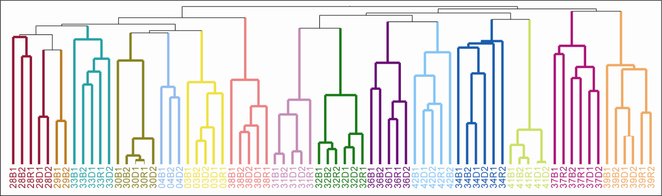
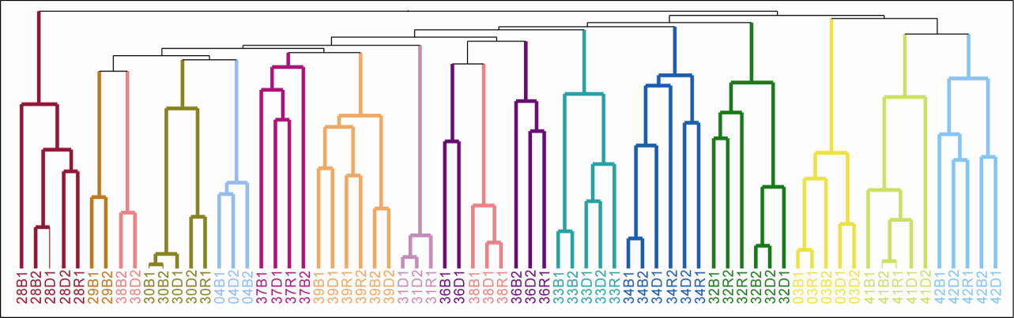
People are islands…
OTUs at 97%
ARISA
Human gut microbial communities are distinctly individual
Individuality persists despite common diet and conditions
Melanie D. Spencer, Timothy J. Hamp, Robert W. Reid, Leslie M. Fischer, Steven H. Zeisel, Anthony A. Fodor. Gastroenterology. 2011

Slide 32
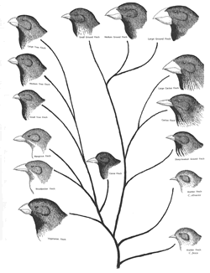

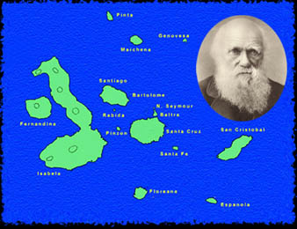
Observations on island biology helped form the theory of evolution
http://pandasthumb.org/archives/2010/01/17/zimmer_beaks_finch_600.jpg
http://people.rit.edu/rhrsbi/GalapagosPages/TitleItems/NewMap1.jpg
http://www.prairiefirenewspaper.com/files/200902-charles-darwin-finches.gif

Slide 33
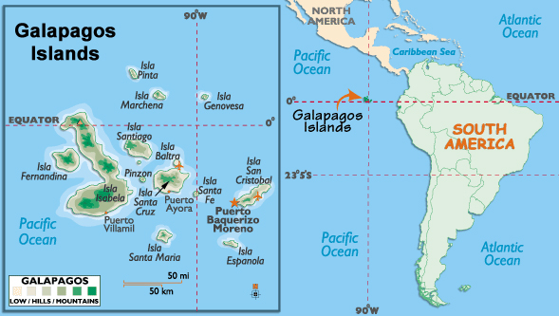

What if you could restart evolution from scratch and observe
how every taxa changes?
http://jmsalsich.edublogs.org/files/2012/04/Galapagos-Islands-Map-1iy98gb.jpg
http://www.aim.org/wp-content/uploads/2013/05/galapagos-islands.jpg

Slide 34
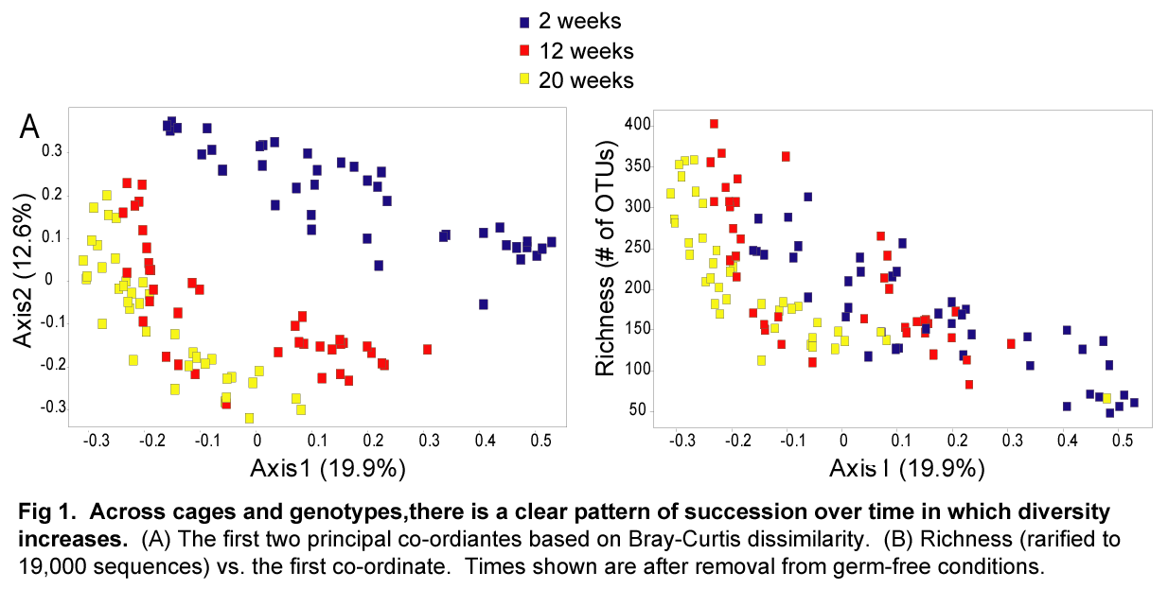
This is an experiment we can now perform…
Stochastic changes over time and not founder effects drive cage effects in microbial community assembly in a mouse model. McCafferty et al- The ISME journal, 2013

Slide 35
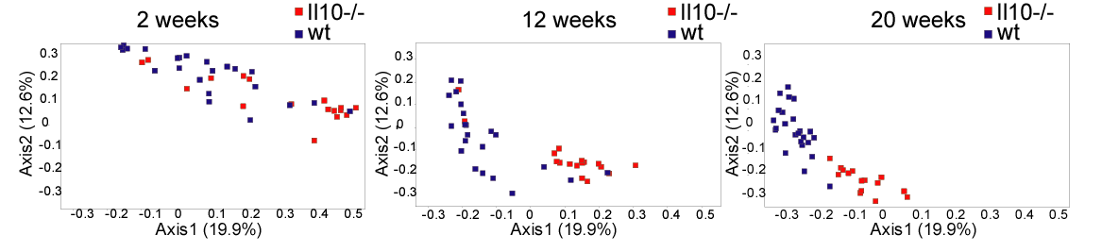
Differences due to inflammation grow over time
Stochastic changes over time and not founder effects drive cage effects in microbial community assembly in a mouse model. McCafferty et al- The ISME journal, 2013

Slide 36
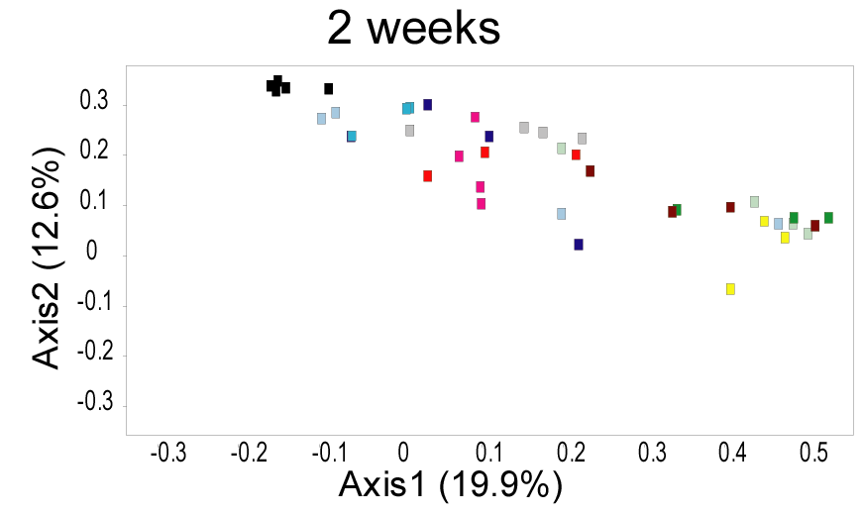
Cage effects are prominent at 2 weeks
Stochastic changes over time and not founder effects drive cage effects in microbial community assembly in a mouse model. McCafferty et al- The ISME journal, 2013

Slide 37
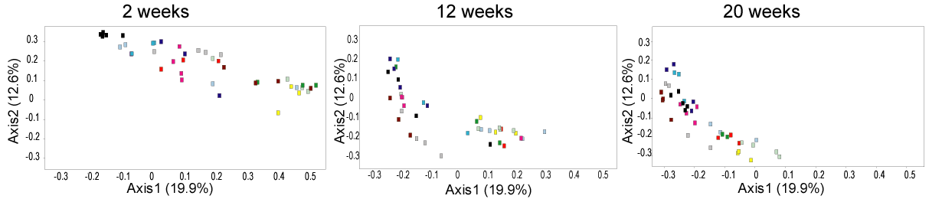
Cages are islands…
Stochastic changes over time and not founder effects drive cage effects in microbial community assembly in a mouse model. McCafferty et al- The ISME journal, 2013

Slide 38
Islands are a problem for statistics….
Mixed linear model:
PcoA Coordinate 1 =
genotype + cage + error
Fixed effect
Random effect
These are highly parametric models:
In addition to standard assumptions of linear models (normality, equal variance)..
Assume that all cages have the same correlation coefficient and can be described by one degree of freedom
This is a more difficult assumption to verify..

Slide 39
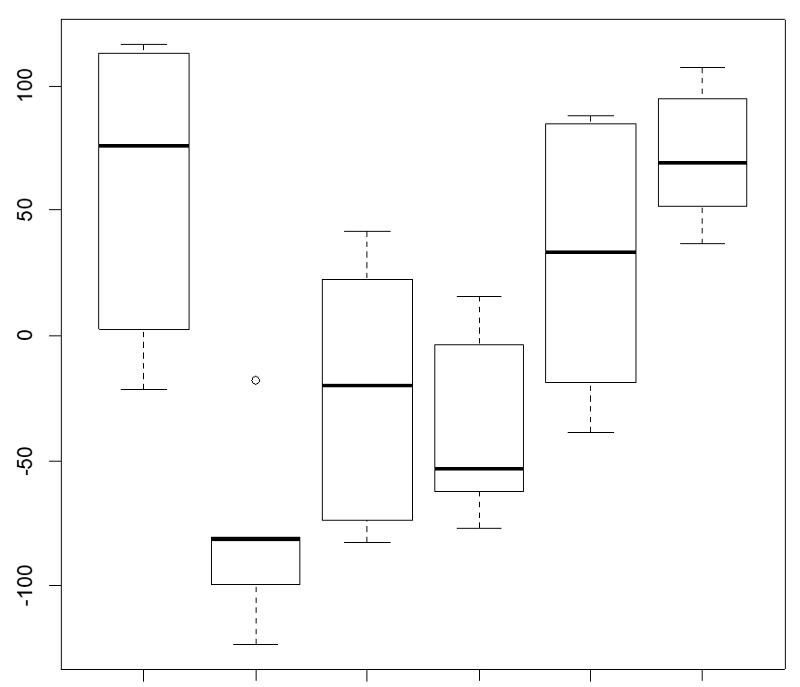
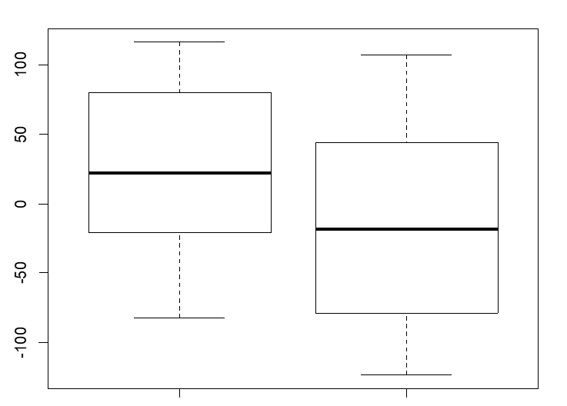
Simulated data with a cage effect by no genotype effect can produce artifactual differences in genotype
WT KO
Cage 1
Cage 2
Cage 3
Cage 4
Cage 5
Cage 6
WT KO
WT KO
WT KO
https://raw.githubusercontent.com/afodor/metagenomicsTools/master/src/mixedModelSims/mixedSims.txt
http://afodor.github.io/classes/stats2017/stats2017.html - lecture 17

Slide 40
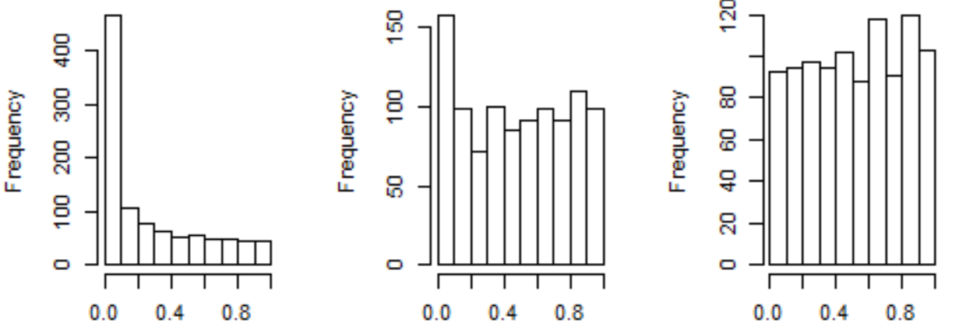
Different implementation of mixed linear models in R can yield different results for hypothesis testing
P-values ignoring cage
Correcting for cage with
the “gls” package in R
Correcting for cage with
the “lme” package in R
https://raw.githubusercontent.com/afodor/metagenomicsTools/master/src/mixedModelSims/mixedSims.txt

Slide 41
Why are effect sizes so small?
Hypothesis: Within a pipeline, measurements are not accurate
Hypothesis: Even with correction for multiple hypothesis testing, there is a tendency for our models to overfit
Hypothesis: Across pipelines, batch effects can induce substantial variation
✓
✓
Hypothesis: Biological “island” effects across space and time impact cross-sectional measures

Slide 42
Why are effect sizes so small?
Hypothesis: Within a pipeline, measurements are not accurate
Hypothesis: Even with correction for multiple hypothesis testing, there is a tendency for our models to overfit
Hypothesis: Across pipelines, batch effects can induce substantial variation
✓
✓
✓
Hypothesis: Biological “island” effects across space and time impact cross-sectional measures

Slide 43
Why are effect sizes so small?
Hypothesis: Within a pipeline, measurements are not accurate
Hypothesis: Even with correction for multiple hypothesis testing, there is a tendency for our models to overfit
Hypothesis: Across pipelines, batch effects can induce substantial variation
✓
✓
✓
Hypothesis: Biological “island” effects across space and time impact cross-sectional measures
Hypothesis: Our assignments of human-state in metadata are crude

Slide 44
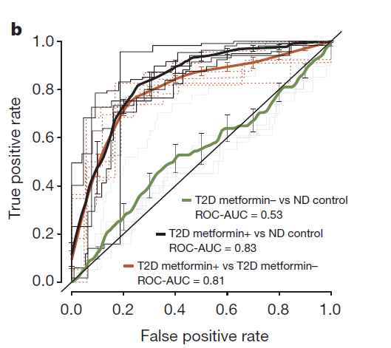
“Disease” state is heavily confounded with drug state
Forslund et al Disentangling type 2 diabetes and metformin treatment signatures in the human gut microbiota– Nature, 2015

Slide 45
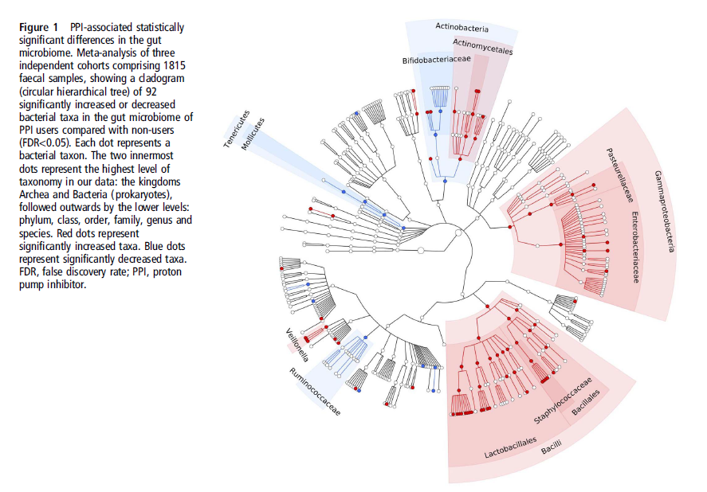
Proton pump inhibitors profoundly change the microbiome
Imhann et al–Proton pump inhibitors affect the gut microbiome Gut, 2015

Slide 46
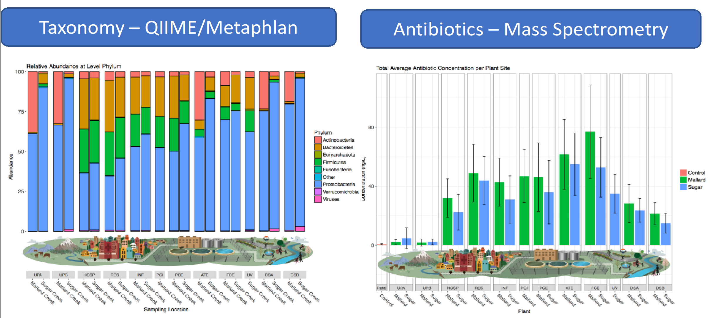
Even the external environment can reflect the omni-presence of pharmacology
Impact of treated wastewater release on antibiotic concentrations and antibiotic resistance markers in urban stream microbial communities
Kevin C. Lambirth, Matthew C. B. Tsilimigras, Anju Lulla, James Johnson, Abrar Al-Shaer, Orion Wynblatt, Shannon Sypholt, Cory Brouwer, Sandra Clinton, Olya Keen, Molly Redmond, Anthony Fodor, Cynthia Gibas. Submitted.

Slide 47

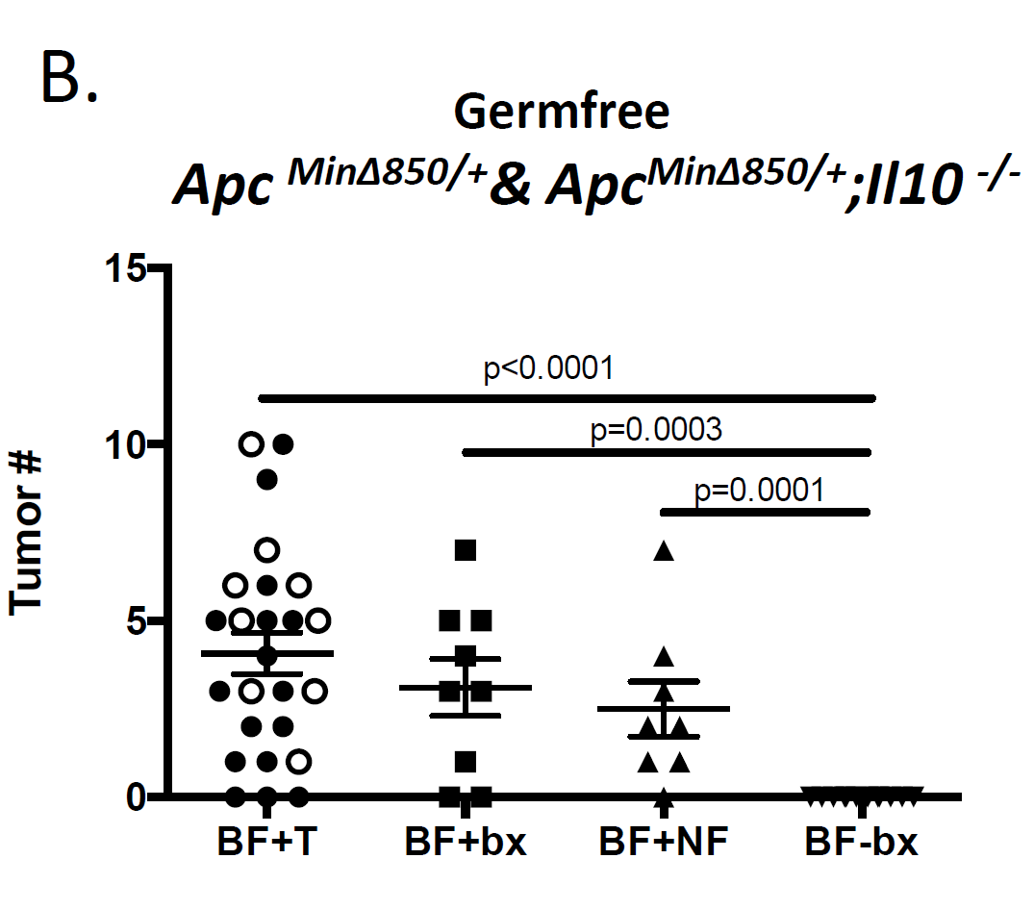
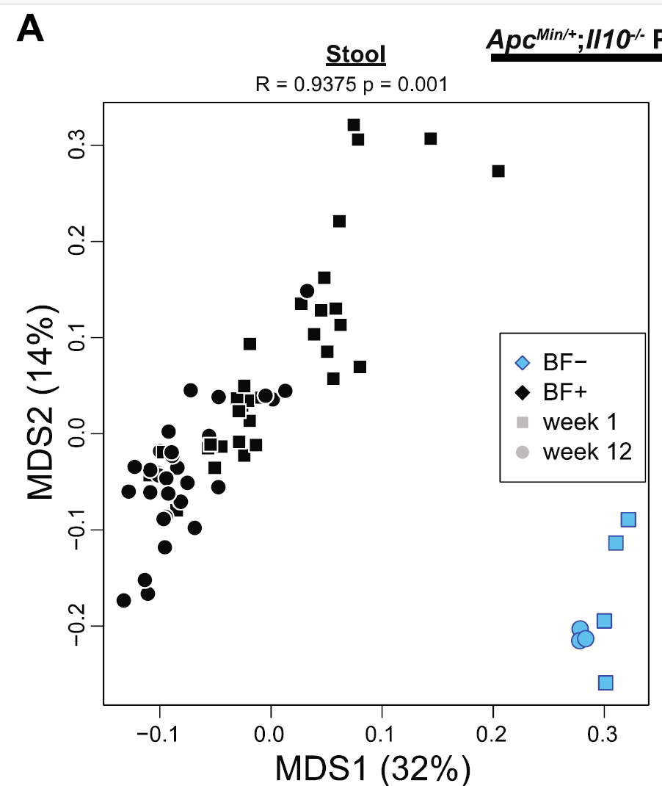
Our notions of “disease” vs. “control” are broad compared to underlying mechanisms
Human colon mucosal biofilms induce IL-17 and are carcinogenic. Sarah Tomkovich ,Christine M. Dejea ,Kathryn Winglee,Payam Fathi ,
Jillian L. Pope,Franck Housseau , Josee Gauthier , Julia L. Drewes , Liam Chung , Xiaolun Sun , Marcus Mühlbauer , Xiuli Liu,
Robert A. Anders, Sepideh Besharati , Ernesto Perez-Chanona ,Anthony A. Fodor , Hua Ding , Xinqun Wu , Shaoguang Wu ,
James R. White , Drew M. Pardoll, Christian Jobin, Cynthia L. Sears. (In preparation)

Slide 48

"Differences in the number of tumors were strongly associated with the baseline microbiome structure in mice, but not with the cancer status of the human donors.".

Slide 49
Why are effect sizes so small?
Hypothesis: Within a pipeline, measurements are not accurate
Hypothesis: Even with correction for multiple hypothesis testing, there is a tendency for our models to overfit
Hypothesis: Across pipelines, batch effects can induce substantial variation
✓
✓
✓
Hypothesis: Biological “island” effects across space and time impact cross-sectional measures
Hypothesis: Our assignments of human-state in metadata are crude

Slide 50
Why are effect sizes so small?
Hypothesis: Within a pipeline, measurements are not accurate
Hypothesis: Even with correction for multiple hypothesis testing, there is a tendency for our models to overfit
Hypothesis: Across pipelines, batch effects can induce substantial variation
✓
✓
✓
Hypothesis: Biological “island” effects across space and time impact cross-sectional measures
Hypothesis: Our assignments of human-state in metadata are crude
✓

Slide 51
Why are effect sizes so small?
Hypothesis: Within a pipeline, measurements are not accurate
Hypothesis: Even with correction for multiple hypothesis testing, there is a tendency for our models to overfit
Hypothesis: Across pipelines, batch effects can induce substantial variation
✓
✓
✓
Hypothesis: Biological “island” effects across space and time impact cross-sectional measures
Hypothesis: Our assignments of human-state in metadata are crude
Hypothesis: Effect sizes are small because biological effects are highly stochastic
✓

Slide 52
Why are effect sizes so small?
Hypothesis: Within a pipeline, measurements are not accurate
Hypothesis: Even with correction for multiple hypothesis testing, there is a tendency for our models to overfit
Hypothesis: Across pipelines, batch effects can induce substantial variation
✓
✓
✓
Hypothesis: Biological “island” effects across space and time impact cross-sectional measures
Hypothesis: Our assignments of human-state in metadata are crude
Hypothesis: Effect sizes are small because biological effects are highly stochastic ????
✓

Slide 53
A metagenomics pipeline consists of many, sometimes difficult to justify, choices
Experimental design
Visualization and statistical analysis
Sample Size (# of cages not just # of mice)
Properly consented cohorts
Capture of confounding variables
Sufficient variation across space and time
Negative and Positive controls
Which diversity metrics?
Log-transform data?
Parametric or non-parametric tests?
Simple linear models?
Mixed models?
Zero-inflated models?
Negative-binomial based models?
Correction for multiple hypothesis testing?
Remove rare taxa?
Track sequencing depth as a confounder.
Track potential biological confounders
(e.g. cage in mouse experiments; drugs in
human surveys)
Supervised classification to build predictive
models? Cross-fold validation?
Random Forest classifiers?
Reproducibility across cohorts and datasets
generated by different labs?
Ordination?
Unifrac (weighted or un-weighted).
or PcOA? With what distance metric
(Bray-Curtis?)
Multi-page, multi-factorial visualizations?
DNA extraction
Which extraction kit/protocol?
Which sequencing platform?
Whole genome or 16S? If 16S, which primers?
sequencing
Merged paired ends? With what parameters?
Qual score filter? With what parameters?
Filter against database of known sequences? With what parameters?
Chimera check? Which algorithm? With what parameters?
Sufficient sequencing depth? Remove unique sequences?
Classification/clustering
Reference database or denovo OTUs? Or something in between?
Which algorithm (RDP, kraken, greengenes, uparse)?
What database? With what parameters?
Are the sequences microbial? From the expected tissue?
Are they just kit microbes?
Normalization
Simple proportions? Rarefication (with what depth?
single rarefication vs. average).
Balance trees? Ratio space? Geometric Mean based normalization?

Slide 54
Every analysis can be a meta-analysis

Slide 55
Consulting:
Salix Corporation
Second Genome

Slide 56


Our lab is hiring:
Research Assistant Professor
Post-doctoral fellows
graduate students
Contact:
afodor@uncc.edu
Image: www.tierpoint.com

Slide 57
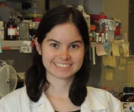






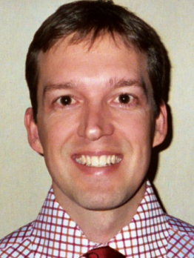




Acknowledgements
UNC-Chapel Hill
Janelle Arthur
Annie Green Howard
Marcus Muhlbauer
Penny Gordon-Larsen
Jonathan Hansen
Temitope Keku
UNC-Charlotte
Roshonda Barner
Ra’ad Gharaibeh
Cynthia Gibas
Jon McCafferty
Michael Sioda
Kathryn Winglee
Matthew Brown
UF- Gainesville
Christian Jobin
USC Vanderbilt University
Tanya L Alderete Martha J. Shrubsole
Michael Goran
Emily Noble
Scott Kanoski
Kathryn Winglee
Annie Green Howard
Penny Gordon-Larsen
Raad Gharaibeh
Jon McCafferty
Marcus Muhlbauer
Janelle Arthur
Christian Jobin

Slide 60
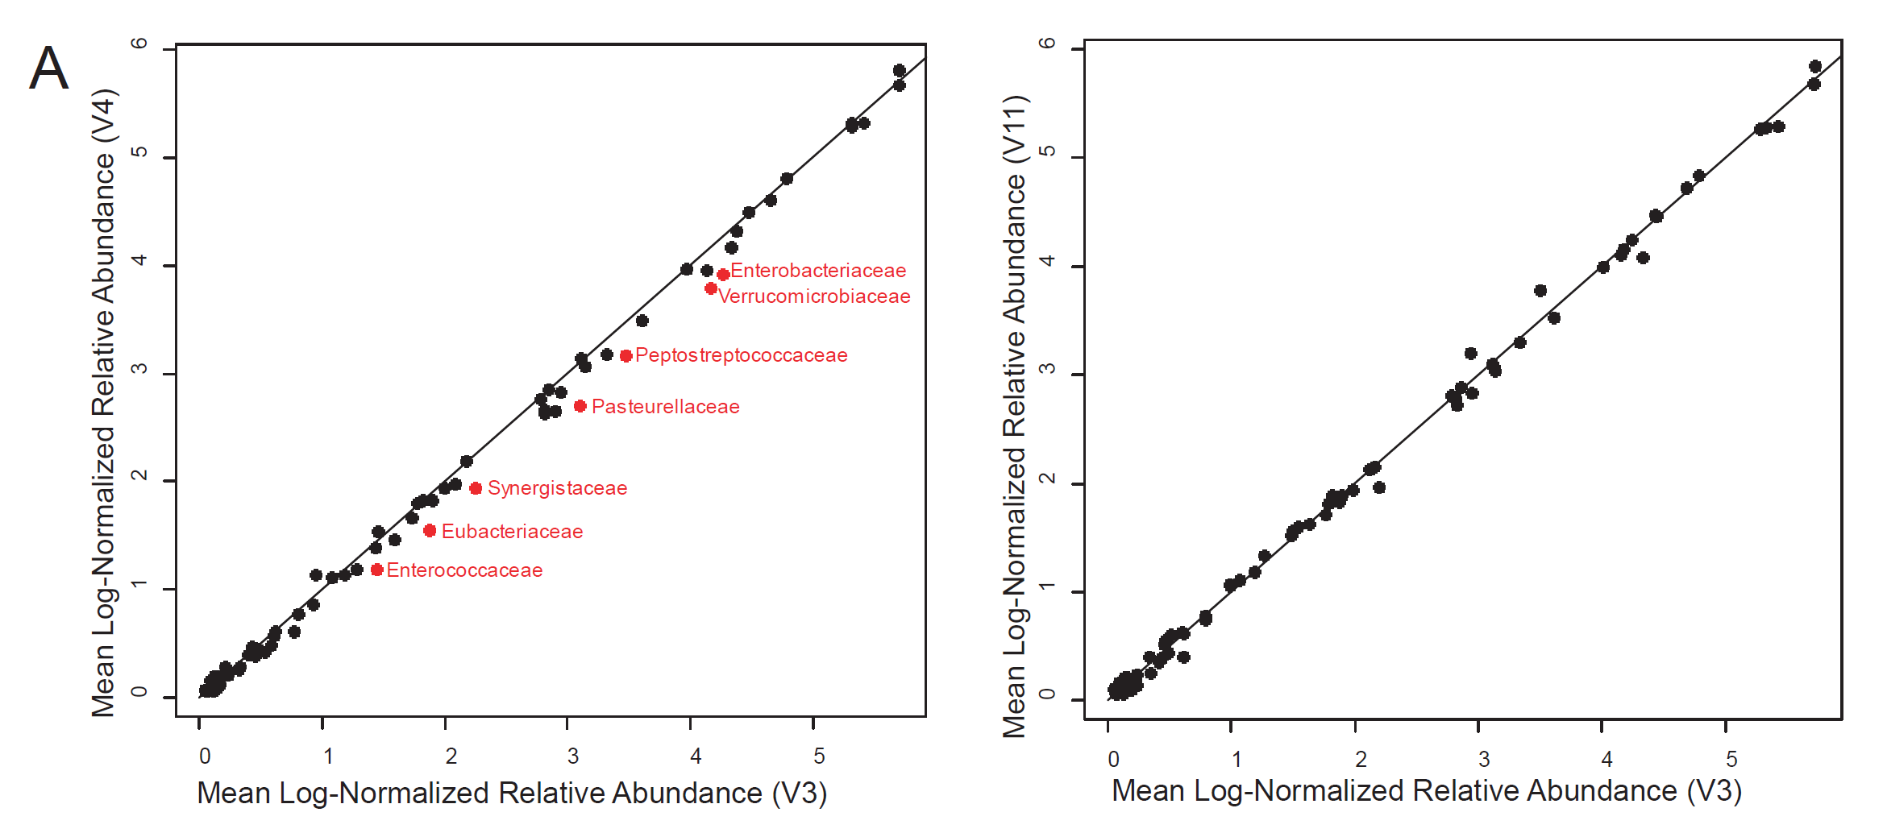
The tendency of the microbial community to be stable over time within individuals is often the dominant signal in measures of community composition
Rifaximin Treatment is Associated With Small, Transient Decreases in Multiple Taxa in the Human Gut Microbial Community. Fodor et al. In revision, Gut Microbes

